Slide 1

Image Dehazing using Image Processing and Machine Learning Techniques
Mid-Review 2
Major Project
Project ID: A4(Alpha 12)
AY 2021-25
GITAM (Deemed-to-be) University
Project Team:
Lokeshwar Reddy K
Tejas V Reddy
Vinay N S
Department of Electrical Electronics and Communication Engineering
Project Mentor:
Dr Jaya Parakash Sahoo
Project In-charge:
Dr Ambar Bajpai
www.gitam.edu

Slide 2
Objective and Goals
Objective
The primary objective is to develop a lightweight CNN-based model for image dehazing that effectively enhances image quality by preserving brightness, color, and clarity. This model will be designed to operate efficiently in real-time applications, support downstream tasks like object detection, and contribute to advancements in image processing research through comprehensive documentation and publication.
Goals
Develop an Efficient Dehazing Model : Build a CNN-based model that effectively removes haze from images while maintaining high visual fidelity.
Enhance Real-Time Usability : Design the model to be lightweight and fast, suitable for applications such as autonomous driving and surveillance.
Ensure Robustness and Accuracy : Create a model capable of handling complex haze scenarios without introducing artifacts or degrading image quality.

Slide 3
Benchmark Performance : Validate the model against synthetic and real-world datasets, establishing performance benchmarks and ensuring reliability.
Support Downstream Tasks : Optimize the dehazed outputs to improve accuracy in related tasks like object detection and tracking in challenging environments.
Simplify Deployment : Develop a scalable and deployable framework to facilitate the practical application of the model in various industries.
Contribute to the Research Community : Share insights and advancements by publishing research findings in IEEE conferences and other reputable platforms.
Document Results Thoroughly : Record methodologies, findings, and performance metrics to ensure transparency and reproducibility of the research.

Slide 4
Project Plan
Phase | Timeline(Dec24 – Mar25) | Activities
Project Planning | Week 1-Week 2 | Literature review, defining objectives, and preparing the research framework.
Data Collection | Week 3-Week 5 | Collecting the foggy(hazy) real time datasets.
Algorithm Development | Week 6-Week 7 | Testing the RESIDE datasets and Writing the algorithm as per adopted steps.
Testing and Validation | Week 8-Week 10 | Testing the collected real-time data with the trained reside datasets.
Implementation | Week 11-Week 13 | Implementation of the project with the collected datasets and ensuring the proper output.
Documentation | Week 14-Week 18 | Documentation of the results of the project and preparing the document for IEEE conference.

Slide 5
Literature Survey (Improved post minor project)
Sl.no | Title of the Paper | Year | Author | Key Findings | Research Gap
1. | DehazeNet: An End-to-End System for Single Image Haze Removal | 2016 | Bolun Cai Xiangmin Xu Kui Jia Chunmei Qing Dacheng Tao | Approach :Developed an end-to-end CNN to estimate medium transmission maps directly from input hazy images. Used the atmospheric scattering model for haze-free image recovery. DecompositionTechnique: 1. Feature Extraction 2. Multi-scale mapping 3. BReLU activation 4. Guided Image Filtering Results: Achieved superior performance compared to seven existing methods, in terms of both haze removal and preservation of image details. High-quality dehazing with sharp contrasts, applicable for industrial systems like autonomous vehicles and surveillance. | Struggles with distant objects in images with progressively increasing haze. Suggests future work in developing lightweight models and unsupervised methods to reduce reliance on labeled datasets. Limited availability of real-world haze-clear image pairs for training.

Slide 6
Literature Survey (Improved post minor project)
Sl.no | Title of the Paper | Year | Author | Key Findings | Research Gap
2. | Single Image Dehazing via Fusion of Multilevel Attention Network for Vision-Based Measurement Applications | 2023 | Geet Sahu Ayan Seal Joanna Jaworek-Korjakowska Ondrej Krejcar | Approach : An encoder-decoder network (UNet) is the backbone. The model incorporates multiscale attention mechanisms (SA and CA) for haze feature extraction and refinement. Technique: SA-Unet and CA-Unet Combined outputs using elementwise addition for superior performance. Structural Similarity Index (SSIM) used as a loss function to improve optimization and convergence. Results: Demonstrated robustness to varying haze densities, atmospheric light conditions, and image scales. Processes a 640×480 image in approximately 1.5 seconds on a CPU. | The assumption of a globally constant atmospheric light limits accuracy for certain real-world scenarios. The model does not directly learn the atmospheric scattering parameters, which could enable end-to-end optimization.

Slide 7
Literature Survey (Improved post minor project)
Sl.no | Title of the Paper | Year | Author | Key Findings | Research Gap
3. | LID-Net: A lightweight image dehazing network for automatic driving vision systems | 2024 | Fazhan Tao Qi Chen Zhigao Fu Longlong Zhu Baofeng Ji | Approach: LID-Net employs a multi-scale architecture Haze Extraction (HE) blocks Haze Removal (HR) blocks Technique: Directly learning the mapping between hazy and clear images without relying on the atmospheric scattering model, thus avoiding color distortion. Utilizing a combination of standard and dilated convolutions to expand the receptive field and extract global information from hazy images. Results: LID-Net demonstrated superior performance in dehazing effectiveness compared to traditional methods and other deep learning approaches, as evidenced by experiments conducted on two real-world foggy weather datasets. | The study addresses limitations in traditional image dehazing methods, which often rely on simplistic assumptions about haze distribution and fail to generalize across different environments. LID-Net's approach mitigates these issues by not depending on the atmospheric scattering model, thus providing a more robust solution for various driving conditions.

Slide 8
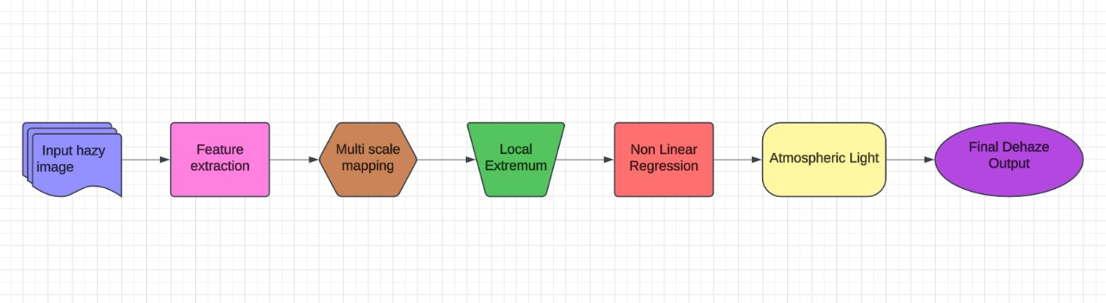
Flow chart

Slide 9
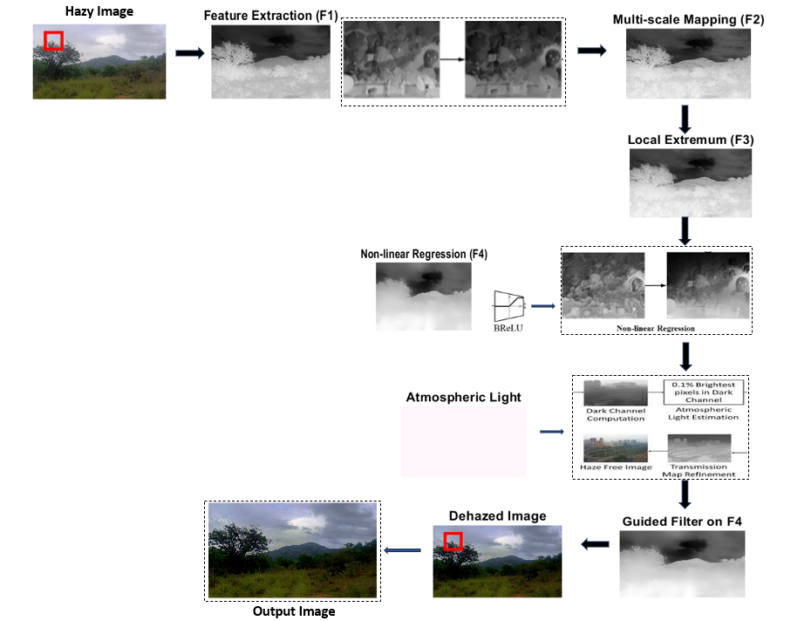
Block Diagram

Slide 10
Use Cases & Testing
Test Cases
Datasets:
DehazeNet was tested on synthetic datasets (e.g., RESIDE) and real-world hazy images to ensure both quantitative and qualitative reliability.
Synthetic datasets allowed ground-truth comparisons, while real-world images validated its robustness.
Quantitative Evaluation:
Metrics like PSNR (Peak Signal-to-Noise Ratio) and SSIM (Structural Similarity Index) were used to objectively evaluate the dehazing quality.
Qualitative Evaluation:
Visual inspection confirmed that DehazeNet effectively restores clarity, contrast, and colour fidelity in hazy images.
Cross-Condition Testing:
Tested under diverse conditions such as varying haze densities, lighting environments, and weather types (e.g., fog, smog).
Real-Time Application:
Testing showed that DehazeNet performs efficiently enough for real-time or near-real-time applications, making it suitable for dynamic systems like autonomous vehicles and live video feeds.
Use Cases
Photography and Videography:
DehazeNet can enhance image quality in outdoor photography and video capture under hazy conditions, making it ideal for professional and consumer-level applications.
Surveillance Systems:
Improves visibility in surveillance footage captured in foggy or smoggy environments, aiding security and monitoring tasks.
Autonomous Vehicles:
Enhances the clarity of images captured by cameras in autonomous cars, ensuring better scene understanding in adverse weather conditions.

Slide 11
Implementation and Results – Iteration 1
Iteration 1 : Results
1. Data Preparation
Datasets Used:
Synthetic Hazy Images: SOTS dataset (from RESIDE benchmark).
Real-World Hazy Images: Collected using online repositories and personal contributions.
Preprocessing:
Resize images to 1200x1600x1200.
Split datasets into training, validation, and testing sets.
2. Model Design
Architecture:
A lightweight convolutional neural network (CNN) with fewer parameters for real-time efficiency.
Incorporates residual blocks to enhance feature extraction.
Includes brightness compensation layers to adjust for color and clarity preservation.
Key Features:
Convolutional Layers: Extract spatial features..
Activation Function: Leaky ReLU for non-linearity.
Output Layer: Reconstructs the dehazed image.

Slide 12
Implementation and Results – Iteration 2
Iteration : Results + Validation against the use cases and test cases
3.Training
Loss Function:
Combination of Mean Squared Error (MSE) for pixel-wise accuracy and Structural Similarity Index Measure (SSIM) loss for perceptual quality.
Optimizer:
Adam optimizer with an initial learning rate of 0.0001.
4. Evaluation Metrics
PSNR (Peak Signal-to-Noise Ratio): Measures image reconstruction quality.
SSIM (Structural Similarity Index): Evaluates the perceptual similarity of dehazed images.

Slide 13
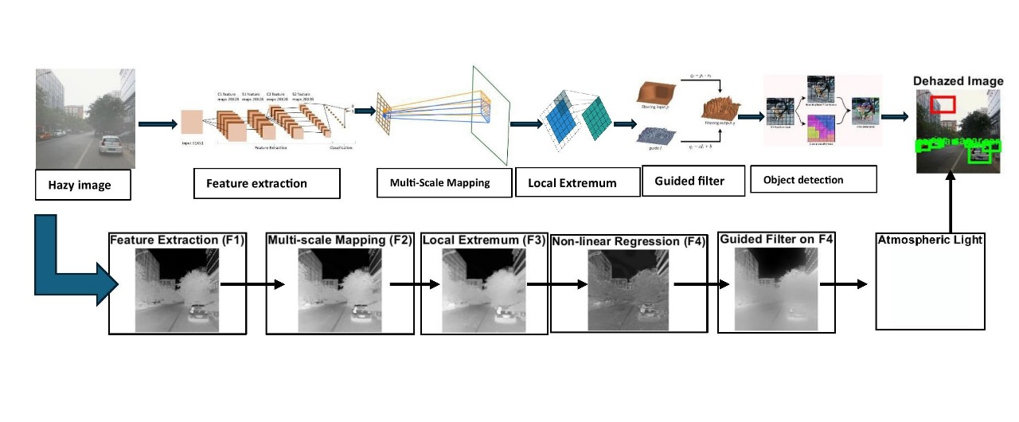
Architecture Diagram

Slide 14
1.Guided Filtering
Guided filtering preserves the edges during the haze removal. They will, hence, compute local means and variances to refine the transmission map with a window of radius 𝑟 and regularization parameter 𝜖.
2. Feature extraction
Key feature extraction of the regions affected by haze is performed through convolutional layers with pre-trained weights. Also, feature pooling will take place to reduce redundancy and focus on haze critical areas.
3.Multi-scale mapping
The features are processed at multiple scales using 3×3, 5×5, and 7×7 convolutional kernels respectively, in such a way that haze structures of different sizes are taken into account.
4. Local Extremum
Max-filtering helps acquire the strongest haze-related features, thus making the model robust to outliers.
5. Nonlinear Regression
The regression layers connect the features extracted from their respective corresponding haze-free outputs to ensure pixel-level accuracy and naturalness. Nonlinear regression maps extracted features to a haze-free image using activation
functions to ensure values remain within the valid range.
6. Atmospheric illumination estimation
For atmospheric light estimation, the brightest regions in the haze-free feature map are captured and utilized to correct color fidelity.

Slide 15
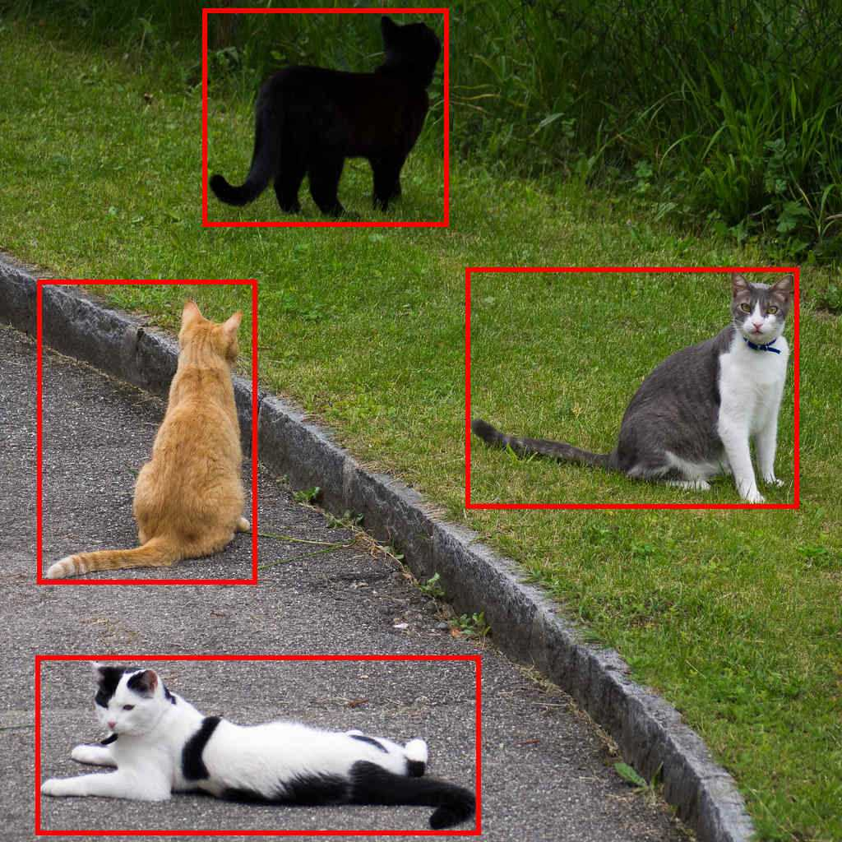

7.Region of interest(ROI)
A region of interest (ROI) is a section of an image that is chosen for analysis or processing.
8. Object Detection using YOLO
The YOLO (You Only Look Once) object detection framework is employed to identify and label objects in both the hazy and dehazed images. YOLO is known for its real time, fast processing and high accuracy, making it an ideal choice for detecting objects in dynamic environments. YOLO's object detection works by dividing the input image into a grid and predicting bounding boxes and class probabilities for each grid cell.
ROI(Region of Interest)
Object Detection using YOLO

Slide 16
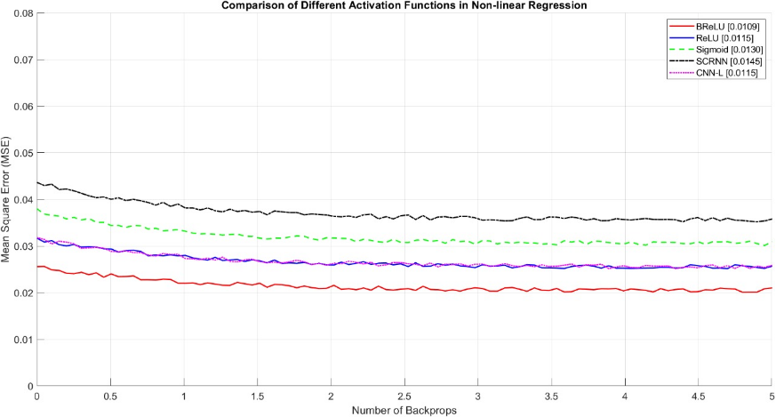

Slide 17
Performance Comparison of Activation Functions
Evaluated activation functions: BReLU, ReLU, Sigmoid, SCRNN, and CNN-L in a non-linear regression task.
Analyzed their Mean Square Error (MSE) over multiple backpropagations.
Best Performing Activation Function
BReLU (red line) achieved the lowest MSE of 0.0109, outperforming others.
CNN-L and ReLU followed closely, stabilizing around 0.0115.
Moderate & Poor Performers
Sigmoid (green dashed line) converged to an MSE of 0.0130, showing moderate performance.
SCRNN (black dashed line) had the highest error, settling at 0.0145, indicating weaker learning capability.
Insights & Implications
BReLU’s superior performance is likely due to better gradient flow and handling of non-linearity.
ReLU and CNN-L also showed competitive results, making them viable choices.
SCRNN’s higher error suggests it may not be suitable for non-linear regression tasks.
Conclusion
Choice of activation function significantly impacts model accuracy.
Using optimal activation functions can improve learning efficiency and minimize errors in neural networks.

Slide 18
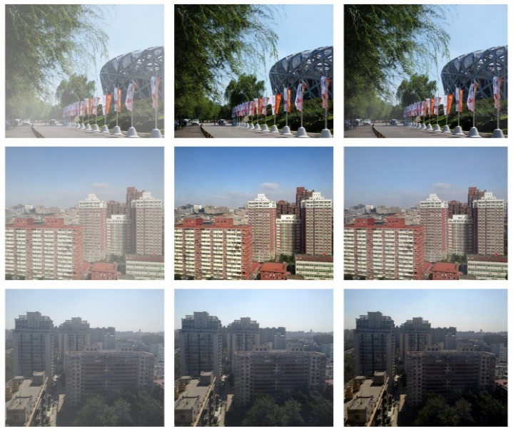
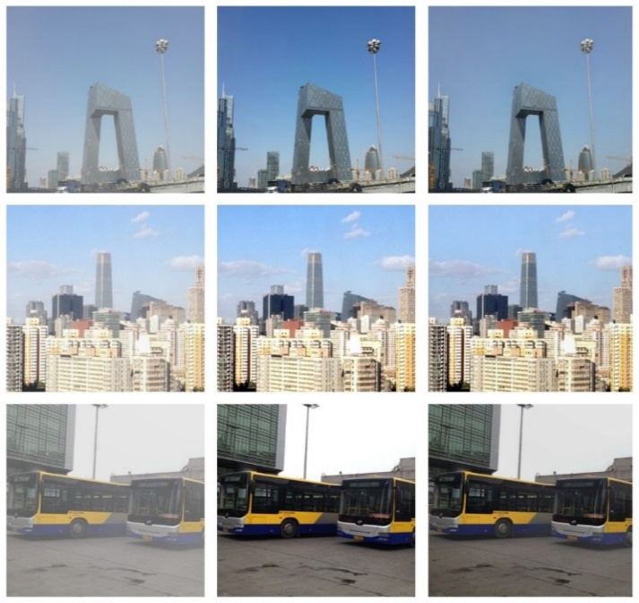
Experimental analysis
1.Qualitative analysis
(a) Hazy
(b)Ground truth
(c)Dehazed
(a) Hazy
(b)Ground truth
(c)Dehazed

Slide 19
2.Quantitative analysis
Metric | Value
PSNR (Peak Signal-to-Noise Ratio) | 22.40 dB
SSIM (Structural Similarity Index) | 0.9460
Accuracy (SSIM) | 94.60%
MSE (Mean Squared Error) | 374.02

Slide 20
Comparision with other methods
Metric | Hazy | ATM [39] | BCCR [11] | FVR [38] | DCP [9] | CAP^2 [18] | RF [17] | DehazeNet | Our method (for single image)
MSE | 0.0481 | 0.0689 | 0.0243 | 0.0155 | 0.0172 | 0.0075 (0.0068) | 0.0070 | 0.0062 | 0.00575
SSIM | 0.9936 | 0.9890 | 0.9963 | 0.9973 | 0.9981 | 0.9991 (0.9990) | 0.9989 | 0.9993 | 0.9460
PSNR | 61.5835 | 60.8612 | 65.2794 | 66.5450 | 66.7392 | 70.0029 (70.6581) | 70.0099 | 70.9767 | 22.40
WSNR | 8.5958 | 7.8492 | 12.6230 | 13.7236 | 13.8508 | 16.9873 (17.7839) | 17.1180 | 18.0996 | −1.1644

Slide 21
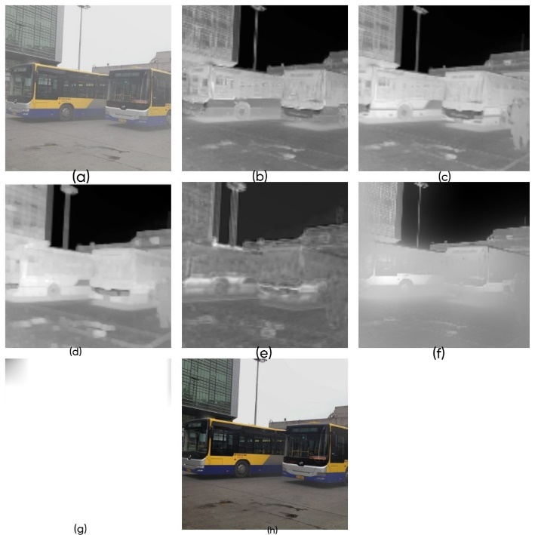
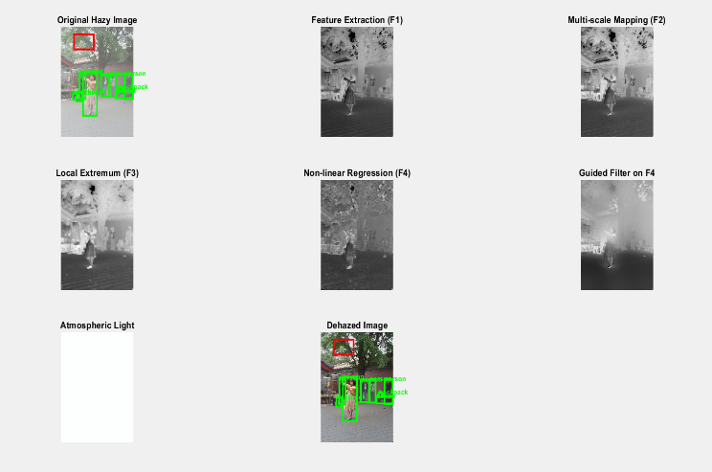
Results
Dehazed image output
Dehazed image with ROI and Object detection

Slide 22
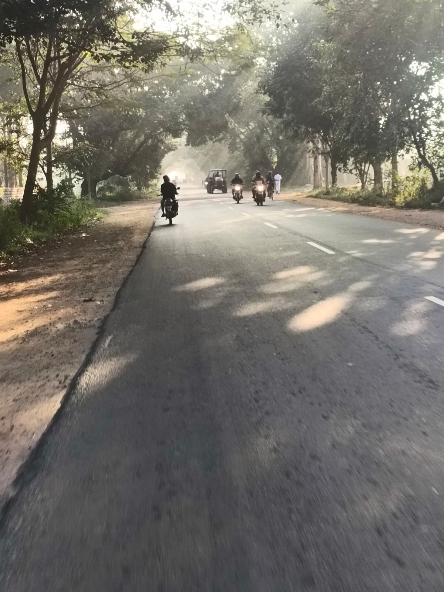
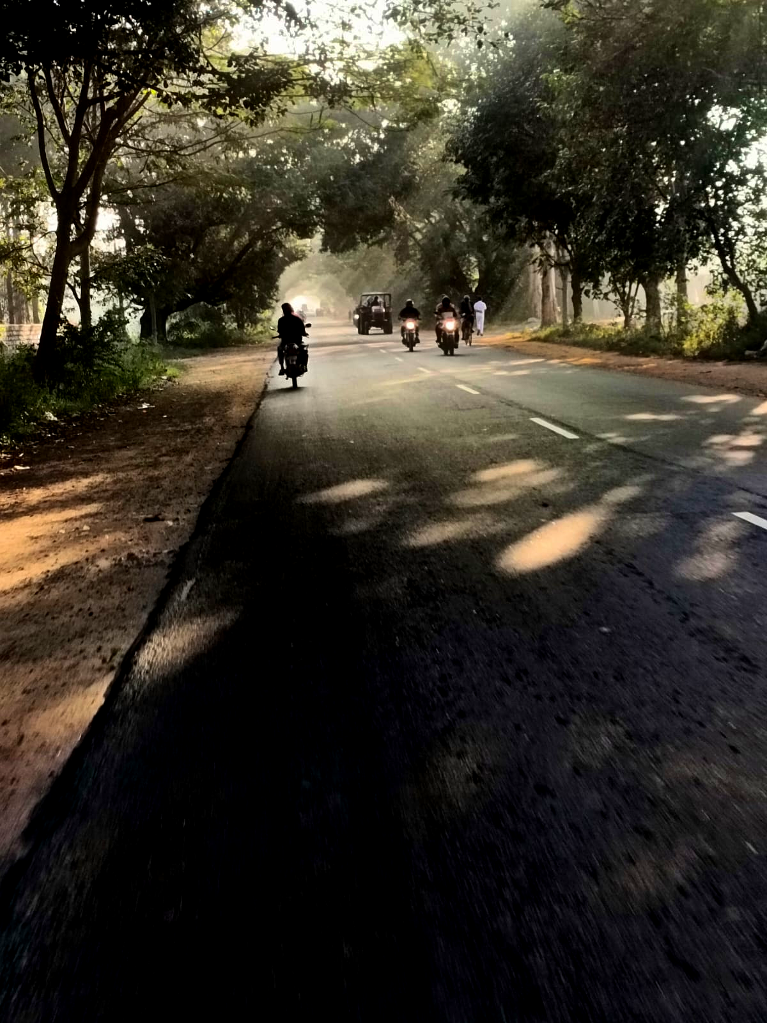
REAL TIME DATASET OUTPUT
HAZY IMAGE
DEHAZED IMAGE

Slide 23
Contribution
Team Progress and Movement
Completed Testing and Validation for datasets.
Explored with Real-Time collected datasets.
Developed an Algorithm for Image Dehazing.
Completed testing the various types of Hazy images.
Paper Documentation is in progress.
Individual Contribution
Key contributions: Lokeshwar Reddy K
Algorithm development
Design and Implementation
Key contributions:Tejas V Reddy
Experimental Evaluation
Testing and Validation
Key contributions: Vinay N S
Collecting datasets
Documentation

Slide 24
Conclusion & Future Work
Summary and Conclusion
Overview:
introduced a novel CNN-based, end-to-end system for single-image haze removal.
Achieved significant improvements in clarity, contrast, and color restoration compared to traditional methods.
Performance and Applications:
Demonstrated superior results on quantitative metrics (PSNR, SSIM) and visual comparisons.
Suitable for real-time applications like surveillance, autonomous vehicles.
Future Work
Conference Paper preparation: Documentation of the project to present in the IEEE conference.

Slide 25
THANK YOU
Have a Great Day !

